Slide 1
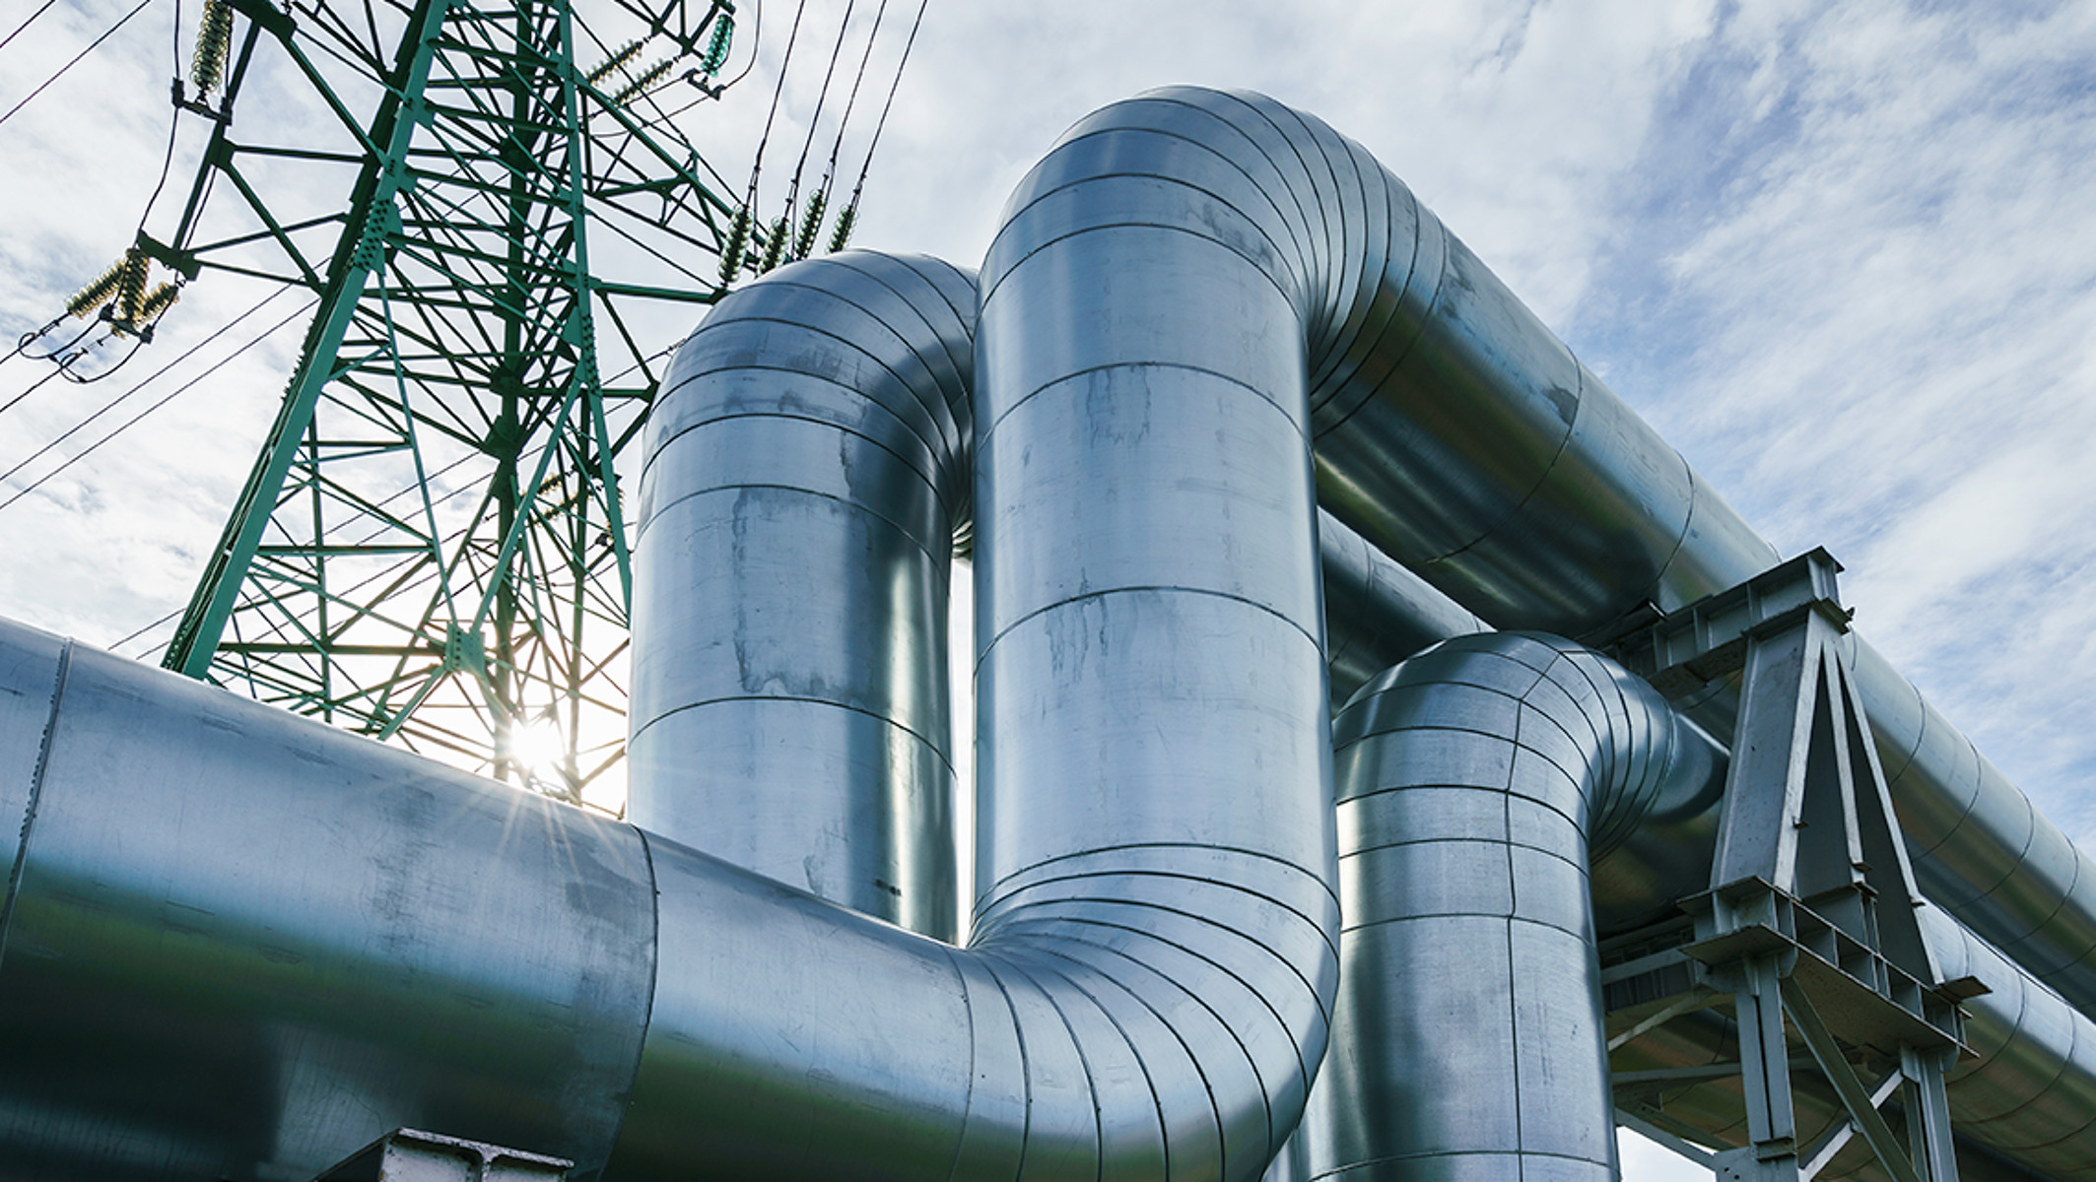
MINI PROJECT
TRANSIENT ANALYSIS IN WATER TANK AND DISTRIBUTION SYSTEM
BY – AALBIN SIMON
ROLL NO. - 234104609

Slide 2
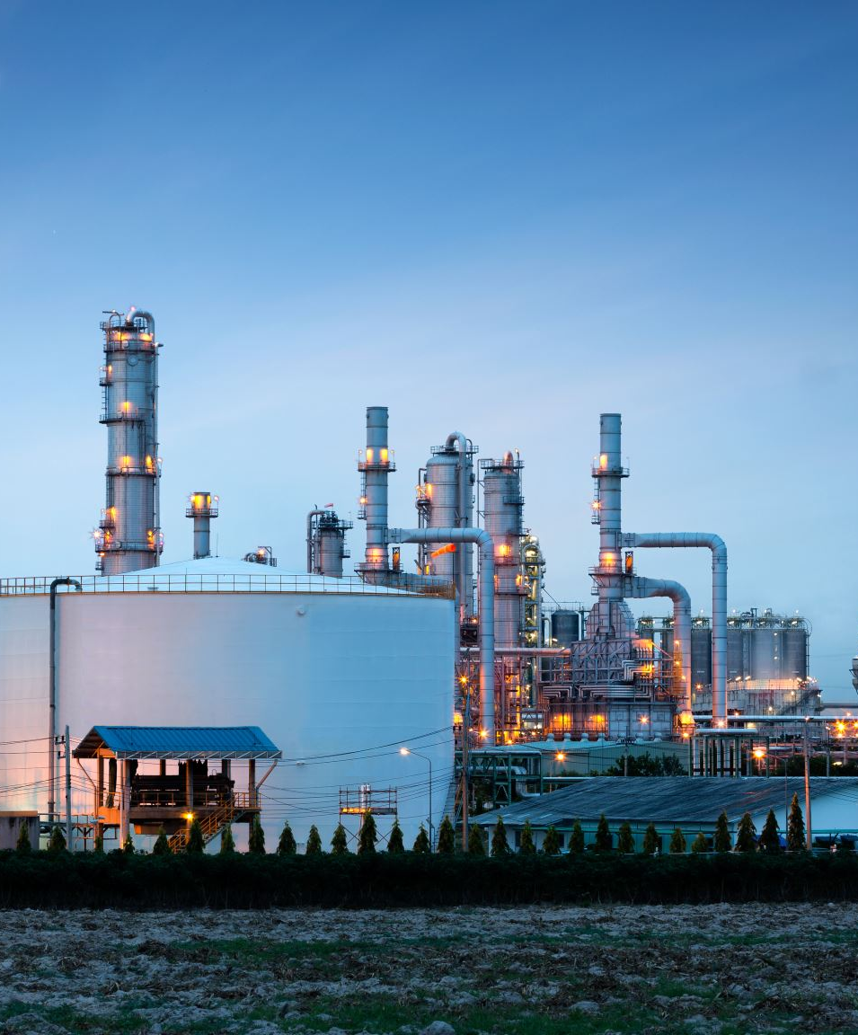
Introduction
The study of transients encompasses a broad spectrum of phenomena, ranging from the familiar water hammer effects in piping systems to the transient response of hydraulic circuits, the startup and shutdown dynamics of pumps and turbines, and even the behavior of natural fluid systems such as rivers and estuaries in response to sudden changes in flow or boundary conditions.
Understanding transients is not merely an academic pursuit; it is a practical necessity for engineers and scientists involved in the design, operation, and maintenance of fluid systems across various industries, including water distribution networks, oil and gas pipelines, power generation facilities, aerospace applications, and environmental modeling.

Slide 3

OBJECTIVE
In this mini project we will be developing a mathematical model to analyse transient in the system for different sections, time and values of discharge and pressure head.

Slide 4

Literature review
Transient analysis in the context of water tanks and pipe valves refers to the study of dynamic behaviour and changes in pressure, flow rate, and other parameters in a fluid system over time. It is particularly important in understanding and predicting phenomena such as water hammer, which occurs when there are sudden changes in flow velocity or direction within a piping system.
Understanding the effects of transient events like water hammer is crucial for ensuring system safety. By conducting transient analysis, engineers can identify potential hazards and vulnerabilities in the system, such as weak points in piping or insufficient pressure relief measures. This information enables the implementation of appropriate safety measures to mitigate risks and prevent accidents such as pipe bursts or equipment failures.
Overall, the effect of transient analysis in water tanks and pipe valves is to enhance system performance, safety, and reliability, leading to more efficient operation and reduced risks for operators and the environment. By leveraging transient analysis techniques, engineers and operators can make informed decisions throughout the lifecycle of fluid systems, from design and construction to operation and maintenance.

Slide 5
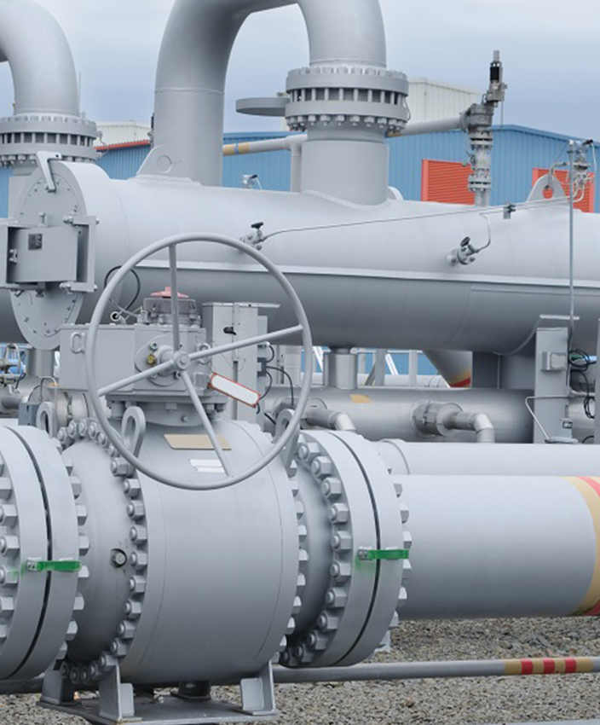
Causes OF TRANSIENTS
Valve Operations: Opening or closing valves abruptly can lead to sudden changes in flow velocity and direction, causing pressure surges and transient effects in the pipe network. This is particularly significant in systems where large volumes of water are moving at high velocities, such as in water distribution networks or industrial piping systems.

Slide 6
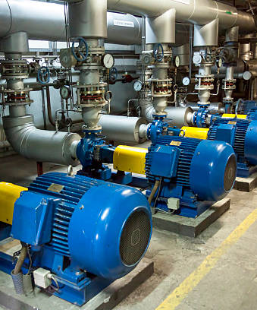
Causes OF TRANSIENTS
Pump Start/Stop: Starting or stopping pumps in a pipeline system can also generate transients. When a pump starts, there is often a rapid increase in flow rate, which can cause pressure surges and water hammer effects downstream. Similarly, when a pump stops, the sudden cessation of flow can lead to pressure fluctuations and transient responses.

Slide 7
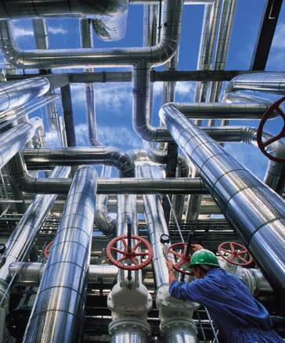
Causes OF TRANSIENTS
Changes in Flow Rate: Any sudden changes in flow rate within the pipeline, whether due to changes in demand, valve operations, or pump operations, can induce transients. For example, if a large consumer suddenly opens a valve to draw water, it can create a surge in flow rate and subsequent pressure fluctuations.

Slide 8

Causes OF TRANSIENTS
Water Column Separation: In certain scenarios, such as during rapid valve closure or pump shutdown, the momentum of the moving water can cause the water column to separate, creating a vacuum or air pocket within the pipeline. The collapse or compression of this air pocket can generate intense pressure waves, leading to water hammer effects.

Slide 9
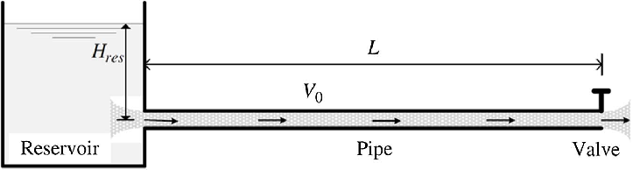
System
A water tank of head 15 m has been used for this analysis and pipe connecting it to the valve.
Pipe is of diameter 0.35 m and length 100 m with a thickness of 0.01 m.
Modulus of elasticity (E) = 2.15*10⁹
Entry loss is taken 0.5 (k_entry)
The pipe has been divided into 5 sections and 6 nodes.

Slide 10
BOUNDARY CONDITIONS
At time (t) = t_0
1. The valve is instantaneously closed
2. Flow through the valve reduces to zero instantly
3. When V = 0 the conversion of the kinetic energy takes place
The pressure rises at the valve
A pressure wave travels in the upstream direction
4. This wave is reflected from the reservoir
5. The wave travels back and forth between the closed valve and the reservoir
6. Due to losses in the system, this wave is dissipated as it travels in the pipeline
7. Finally the flow is completely stopped and the pressure in the entire pipeline becomes same as the reservoir head.

Slide 11
ANALYSIS
ANALYSIS OF DISCHARGE
Discharge Vs Time graph has been plotted using the code through which we got values at different sections.
In this graph we can see maximum and minimum discharge value are produced for a section.

Slide 12
ANALYSIS
ANALYSIS OF PRESSURE HEAD
Pressure head Vs Time graph has been plotted using the code for multiple sections.
Maximum and minimum pressure head values are produced for a section

Slide 13

conclusion
With these results that we have got, it's easy to design the system as the maximum and minimum values of the pressure head have been seen.
Through improving our knowledge of transient flow dynamics and offering useful insights for maximising system resilience and performance, this work advances the engineering of transient analysis in water system. To guarantee the dependable and effective operation of water supply networks, more study in this field can concentrate on improving modelling techniques, investigating sophisticated control systems, and incorporating real-time monitoring technology.

Slide 14
THANK YOU

